Slide 1

Apex Institute of Technology
Department of Computer Science & Engineering
Computer Organization & Architecture
(CST-281)
Jayashree Mohanty
E15737
Assistant Professor
CSE(AIT), CU
DISCOVER . LEARN . EMPOWER

Slide 2
About Course
This course is introduced to 4th semester students of BE
This course offers a good understanding of the various functional units of a computer system and prepares the students to be in a position to design a basic computer system
In addition to this students will be exposed to the recent trends in parallel and distributed computing and multithreaded application

Slide 3
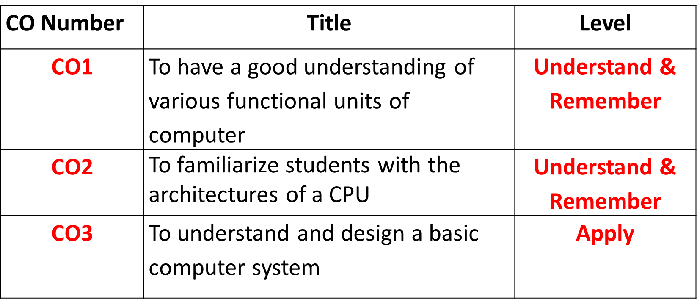
Course Objectives

Slide 4
Introduction: Computer Architecture and Computer Organization
Computer Architecture: Computer Architecture is a functional description of requirements and design implementation for the various parts of computer. It deals with functional behavior of computer system. It comes before the computer organization while designing a computer.
Architecture describes what the computer does.
Computer Organization: Computer Organization comes after the decide of Computer Architecture first. Computer Organization is how operational attribute are linked together and contribute to realise the architectural specification. Computer Organization deals with structural relationship.
Organization describes how it does it.

Slide 5
Differences between computer architecture and organization
Srno. | computer architecture | Computer organization
1 | Architecture describes what the computer does. | Organization describes how it does it.
2 | Computer Architecture deals with functional behavior of computer system. | Computer Organization deals with structural relationship.
3 | it deals with high-level design issue. | it deals with low-level design issue.
4 | Architecture indicates its hardware. | Where, Organization indicates its performance.
5 | Computer Architecture is also called as instruction set architecture. | Computer Organization is frequently called as micro architecture.
6 | Computer Architecture comprises logical functions such as instruction sets, registers, data types and addressing modes. | Computer Organization consists of physical units like circuit designs, peripherals and adders.

Slide 6
Central Processing Unit(CPU)
The full form of CPU is Central Processing Unit. Alternatively, it is also known by the name of processor, microprocessor or a computer processor. A CPU is an electronics circuit used in a computer that fetches the input instructions or commands from the memory unit, performs arithmetic and logic operations and stores this processed data back to memory.
A CPU or Central Processing Unit is the heart of a computer and is install in socket specified on a motherboard. Since a CPU performs a lot of calculations at a high speed, it gets heat up quickly.

Slide 7
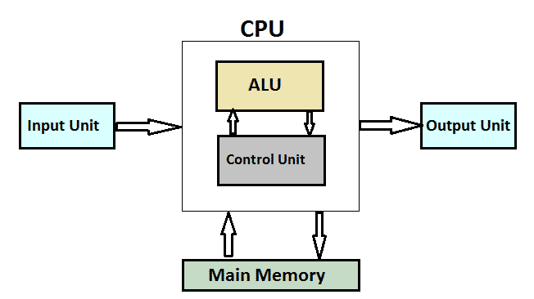
Components of a CPU

Slide 8
Cont…
Control Unit
The Control Unit is an internal part of a CPU that co-ordinates the instructions and data flow between CPU and other component of computer. It is the CU that directs the operations of a central processing unit by sending timing and control signals.
Arithmetic Logic Unit
The ALU is an internal electronic circuitry of a CPU that performs all the arithmetic and logical operations in a computer. The ALU receives three types of inputs.
Control signal from CU ( Control Unit )
Data(operands) to be operated
Status information from operations done previously.
When all the instructions have been operated, the output that consists of data is stored in memory and a status information is stored in internal registers of a CPU.

Slide 9
Cont..
Working of a CPU
All the CPUs regardless of their origin or type performs a basic instruction cycle that consists of three steps named Fetch, decode and Execute.
Fetch
A program consists of a number of instructions. Various programs are stored in memory. During this step, the CPU reads instruction that is to be operated from a particular address in the memory. The program counter of CPU keeps the record of address of the instructions.
Decode
A circuitry called instruction decoder decodes all the instructions fetched from the memory. The instructions are decoded to various signals that control other areas of CPU.
Execute
In the last step, the CPU executes the instruction. For example, it stores a value in the particular register and the instruction pointer then points to other instruction that is stored in next address location.

Slide 10
Objectives
Understand the fundamentals of numerical data representation and manipulation in digital computers.
Master the skill of converting between various radix systems.
Understand how errors can occur in computations because of overflow and truncation.

Slide 11
Introduction
A bit is the most basic unit of information in a computer.
It is a state of “on” or “off” in a digital circuit.
Sometimes these states are “high” or “low” voltage instead of “on” or “off..”
A byte is a group of eight bits.
A byte is the smallest possible addressable unit of computer storage.
The term, “addressable,” means that a particular byte can be retrieved according to its location in memory.

Slide 12
Introduction
A word is a contiguous group of bytes.
Words can be any number of bits or bytes.
Word sizes of 16, 32, or 64 bits are most common.
In a word-addressable system, a word is the smallest addressable unit of storage.
A group of four bits is called a nibble.
Bytes, therefore, consist of two nibbles: a “high-order nibble,” and a “low-order” nibble.

Slide 13
Positional Numbering Systems
Bytes store numbers using the position of each bit to represent a power of 2.
The binary system is also called the base-2 system.
Our decimal system is the base-10 system. It uses powers of 10 for each position in a number.
Any integer quantity can be represented exactly using any base (or radix).

Slide 14
Positional Numbering Systems
The decimal number 947 in powers of 10 is:
The decimal number 5836.47 in powers of 10 is:
9 × 10 2 + 4 × 10 1 + 7 × 10 0
5 × 10 3 + 8 × 10 2 + 3 × 10 1 + 6 × 10 0
+ 4 × 10 -1 + 7 × 10 -2

Slide 15
Positional Numbering Systems
The binary number 11001 in powers of 2 is:
When the radix of a number is something other than 10, the base is denoted by a subscript.
Sometimes, the subscript 10 is added for emphasis:
11001₂ = 25₁₀
1 × 2 4 + 1 × 2 3 + 0 × 2 2 + 0 × 2 1 + 1 × 2 0
= 16 + 8 + 0 + 0 + 1 = 25

Slide 16
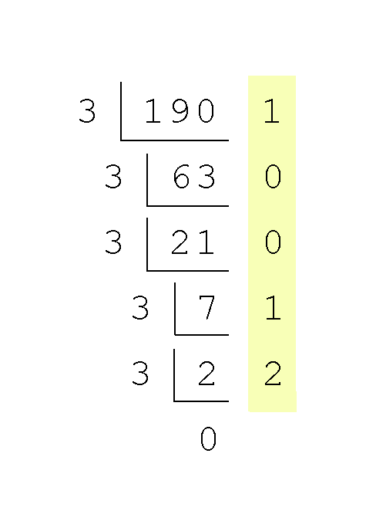
Converting Between Bases
Converting 190 to base 3...
Continue in this way until the quotient is zero.
In the final calculation, we note that 3 divides 2 zero times with a remainder of 2.
Our result, reading from bottom to top is:
190₁₀ = 21001₃

Slide 17
Converting Between Bases
Converting 190 to base 2
190₁₀ = 10111110₂
2 | 190
2 | 95 | 0
2 | 47 | 1
2 | 23 | 1
2 | 11 | 1
2 | 5 | 1
2 | 2 | 1
2 | 1 | 0
 | 0 | 1

Slide 18
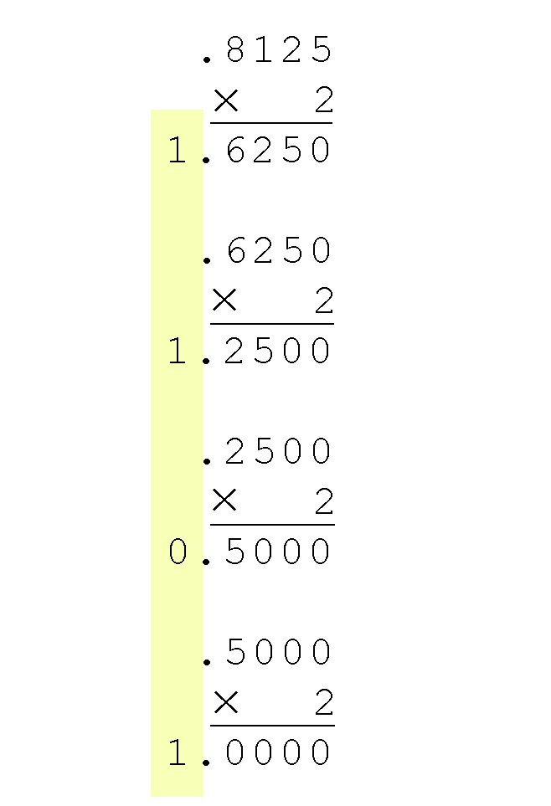
Converting Between Bases
Converting 0.8125 to binary . . .
You are finished when the product is zero, or until you have reached the desired number of binary places.
Our result, reading from top to bottom is:
0.8125₁₀ = 0.1101₂
This method also works with any base. Just use the target radix as the multiplier.

Slide 19
Converting Between Bases
The binary numbering system is the most important radix system for digital computers.
However, it is difficult to read long strings of binary numbers -- and even a modestly-sized decimal number becomes a very long binary number.
For example: 11010100011011₂ = 13595₁₀
For compactness and ease of reading, binary values are usually expressed using the hexadecimal, or base-16, numbering system.

Slide 20
Decimal, Binary, Hexadecimal, Octal
Decimal | Binary | Hexadecimal | Octal
0 | 00000 | 0 | 0
1 | 0001 | 1 | 1
2 | 0010 | 2 | 2
3 | 0011 | 3 | 3
4 | 0100 | 4 | 4
5 | 0101 | 5 | 5
6 | 0110 | 6 | 6
7 | 0111 | 7 | 7
8 | 1000 | 8 | 10
9 | 1001 | 9 | 11
10 | 1010 | A | 12
11 | 1011 | B | 13
12 | 1100 | C | 14
13 | 1101 | D | 15
14 | 1110 | E | 16
15 | 1111 | F | 17

Slide 21
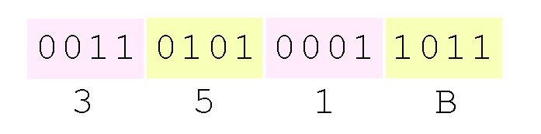
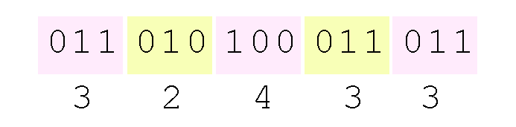
Converting Between Bases
Using groups of hextets, the binary number 11010100011011₂ (= 13595₁₀) in hexadecimal is:
Octal (base 8) values are derived from binary by using groups of three bits (8 = 2³):
If the number of bits is not a multiple of 4, pad on the left with zeros.
Octal was very useful when computers used six-bit words.

Slide 22
Signed Integer Representation
The conversions we have so far presented have involved only unsigned numbers.
To represent signed integers, computer systems allocate the high-order bit to indicate the sign of a number.
The high-order bit is the leftmost bit. It is also called the most significant bit.
0 is used to indicate a positive number; 1 indicates a negative number.
The remaining bits contain the value of the number (but this can be interpreted different ways)

Slide 23
Signed Integer Representation
There are three ways in which signed binary integers may be expressed:
Signed magnitude
One’s complement
Two’s complement
In an 8-bit word, signed magnitude representation places the absolute value of the number in the 7 bits to the right of the sign bit.

Slide 24
Signed Integer Representation
For example, in 8-bit signed magnitude representation:
+3 is: 00000011
- 3 is: 10000011
Computers perform arithmetic operations on signed magnitude numbers in much the same way as humans carry out pencil and paper arithmetic.
Humans often ignore the signs of the operands while performing a calculation, applying the appropriate sign after the calculation is complete.

Slide 25
Signed Integer Representation
Binary addition is as easy as it gets. You need to know only four rules:
0 + 0 = 0 0 + 1 = 1
1 + 0 = 1 1 + 1 = 10
The simplicity of this system makes it possible for digital circuits to carry out arithmetic operations.
We will describe these circuits in Chapter 3.
Let’s see how the addition rules work with signed magnitude numbers . . .

Slide 26
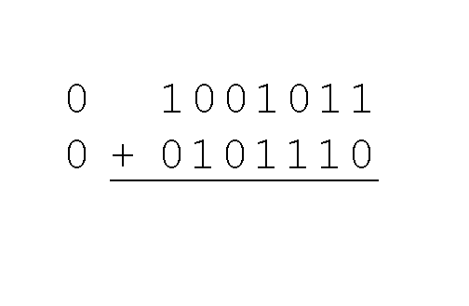
Signed Integer Representation
Example:
Using signed magnitude binary arithmetic, find the sum of 75 and 46.
First, convert 75 and 46 to binary, and arrange as a sum, but separate the (positive) sign bits from the magnitude bits.

Slide 27
Signed Integer Representation
Signed magnitude representation is easy for people to understand, but it requires complicated computer hardware.
Another disadvantage of signed magnitude is that it allows two different representations for zero: positive zero and negative zero.
For these reasons (among others) computers systems employ complement systems for numeric value representation.

Slide 28
Signed Integer Representation
In complement systems, negative values are represented by some difference between a number and its base.
The diminished radix complement of a non-zero number N in base r with d digits is (r^{d} – 1) – N
In the binary system, this gives us one’s complement. It amounts to little more than flipping the bits of a binary number.

Slide 29
Signed Integer Representation
For example, using 8-bit one’s complement representation:
+ 3 is: 00000011
- 3 is: 11111100
In one’s complement representation, as with signed magnitude, negative values are indicated by a 1 in the high order bit.
Complement systems are useful because they eliminate the need for subtraction. The difference of two values is found by adding the minuend to the complement of the subtrahend.

Slide 30
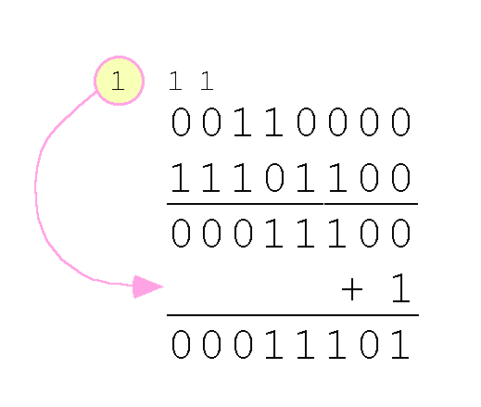
Signed Integer Representation
With one’s complement addition, the carry bit is “carried around” and added to the sum.
Example: Using one’s complement binary arithmetic, find the sum of 48 and - 19
We note that 19 in binary is 00010011,
so -19 in one’s complement is: 11101100.

Slide 31
Signed Integer Representation
Although the “end carry around” adds some complexity, one’s complement is simpler to implement than signed magnitude.
But it still has the disadvantage of having two different representations for zero: positive zero and negative zero.
Two’s complement solves this problem.
Two’s complement is the radix complement of the binary numbering system; the radix complement of a non-zero number N in base r with d digits is r^{d} – N.

Slide 32
Signed Integer Representation
To express a value in two’s complement representation:
If the number is positive, just convert it to binary and you’re done.
If the number is negative, find the one’s complement of the number and then add 1.
Example:
In 8-bit binary, 3 is: 00000011
-3 using one’s complement representation is: 11111100
Adding 1 gives us -3 in two’s complement form: 11111101.

Slide 33
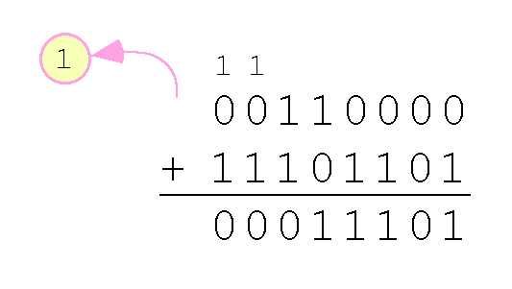
Signed Integer Representation
With two’s complement arithmetic, all we do is add our two binary numbers. Just discard any carries emitting from the high order bit.
Example: Using one’s complement binary arithmetic, find the sum of 48 and - 19.
We note that 19 in binary is: 00010011,
so -19 using one’s complement is: 11101100,
and -19 using two’s complement is: 11101101.

Slide 34
Signed Integer Representation
When we use any finite number of bits to represent a number, we always run the risk of the result of our calculations becoming too large or too small to be stored in the computer.
While we can’t always prevent overflow, we can always detect overflow.
In complement arithmetic, an overflow condition is easy to detect.

Slide 35
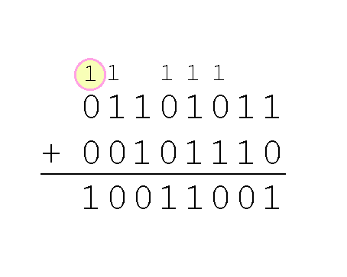
Signed Integer Representation
Example:
Using two’s complement binary arithmetic, find the sum of 107 and 46.
We see that the nonzero carry from the seventh bit overflows into the sign bit, giving us the erroneous result: 107 + 46 = -103.
But overflow into the sign bit does not always mean that we have an error.

Slide 36
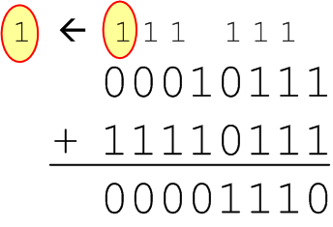
Signed Integer Representation
Example:
Using two’s complement binary arithmetic, find the sum of 23 and -9.
We see that there is carry into the sign bit and carry out. The final result is correct: 23 + (-9) = 14.
Rule for detecting signed two’s complement overflow: When the “carry in” and the “carry out” of the sign bit differ, overflow has occurred. If the carry into the sign bit equals the carry out of the sign bit, no overflow has occurred.

Slide 37
Floating-Point Representation
The signed magnitude, one’s complement, and two’s complement representation that we have just presented deal with signed integer values only.
Without modification, these formats are not useful in scientific or business applications that deal with real number values.
Floating-point representation solves this problem.

Slide 38
Floating-Point Representation
If we are clever programmers, we can perform floating-point calculations using any integer format.
This is called floating-point emulation, because floating point values aren’t stored as such; we just create programs that make it seem as if floating-point values are being used.
Most of today’s computers are equipped with specialized hardware that performs floating-point arithmetic with no special programming required.

Slide 39
Floating-Point Representation
Floating-point numbers allow an arbitrary number of decimal places to the right of the decimal point.
For example: 0.5 × 0.25 = 0.125
They are often expressed in scientific notation.
For example:
0.125 = 1.25 × 10⁻¹
5,000,000 = 5.0 × 10⁶

Slide 40
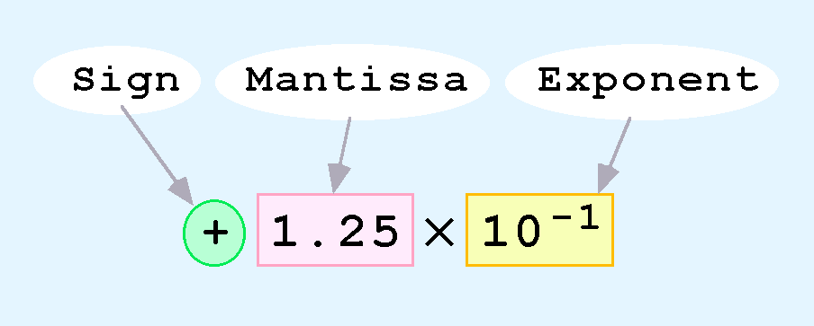
Floating-Point Representation
Computers use a form of scientific notation for floating-point representation
Numbers written in scientific notation have three components:

Slide 41
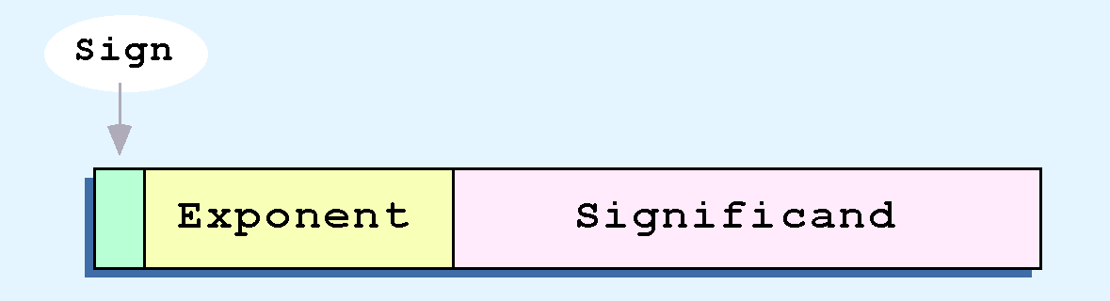
Floating-Point Representation
Computer representation of a floating-point number consists of three fixed-size fields:
This is the standard arrangement of these fields.
Note: Although “significand” and “mantissa” do not technically mean the same thing, many people use these terms interchangeably. We use the term “significand” to refer to the fractional part of a floating point number.

Slide 42
Floating-Point Representation
We introduce a hypothetical “Simple Model” to explain the concepts
In this model:
A floating-point number is 14 bits in length
The exponent field is 5 bits
The significand field is 8 bits

Slide 43
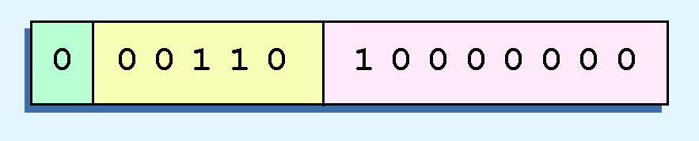
Floating-Point Representation
Example:
Express 32₁₀ in the simplified 14-bit floating-point model.
We know that 32 is 2⁵. So in (binary) scientific notation 32 = 1.0 x 2⁵ = 0.1 x 2⁶.
In a moment, we’ll explain why we prefer the second notation versus the first.
Using this information, we put 110 (= 6₁₀) in the exponent field and 1 in the significand as shown.

Slide 44
Floating-Point Representation
The IEEE has established a standard for floating-point numbers
The IEEE-754 single precision floating point standard uses an 8-bit exponent (with a bias of 127) and a 23-bit significand.
The IEEE-754 double precision standard uses an 11-bit exponent (with a bias of 1023) and a 52-bit significand.

Slide 45
Floating-Point Representation
In both the IEEE single-precision and double-precision floating-point standard, the significant has an implied 1 to the LEFT of the radix point.
The format for a significand using the IEEE format is: 1.xxx…
For example, 4.5 = .1001 x 2³ in IEEE format is 4.5 = 1.001 x 2². The 1 is implied, which means is does not need to be listed in the significand (the significand would include only 001).

Slide 46
Floating-Point Representation
Example: Express -3.75 as a floating point number using IEEE single precision.
First, let’s normalize according to IEEE rules:
3.75 = -11.11₂ = -1.111 x 2¹
The bias is 127, so we add 127 + 1 = 128 (this is our exponent)
The first 1 in the significand is implied, so we have:
Since we have an implied 1 in the significand, this equates to
-(1).111₂ x 2 ^{(128 – 127)} = -1.111₂ x 2¹ = -11.11₂ = -3.75.
(implied)

Slide 47
Character Codes
Calculations aren’t useful until their results can be displayed in a manner that is meaningful to people.
We also need to store the results of calculations, and provide a means for data input.
Thus, human-understandable characters must be converted to computer-understandable bit patterns using some sort of character encoding scheme.

Slide 48
Character Codes
Binary-coded decimal (BCD) was one of these early codes. It was used by IBM mainframes in the 1950s and 1960s.
Decimal Digit | BCD 8 4 2 1
0 | 0 0 0 0
1 | 0 0 0 1
2 | 0 0 1 0
3 | 0 0 1 1
4 | 0 1 0 0
5 | 0 1 0 1
6 | 0 1 1 0
7 | 0 1 1 1
8 | 1 0 0 0
9 | 1 0 0 1

Slide 49
Character Codes
In 1964, BCD was extended to an 8-bit code, Extended Binary-Coded Decimal Interchange Code (EBCDIC). See textbook Page 89
EBCDIC was one of the first widely-used computer codes that supported upper and lowercase alphabetic characters, in addition to special characters, such as punctuation and control characters.
EBCDIC and BCD are still in use by IBM mainframes today.

Slide 50
Character Codes
Other computer manufacturers chose the 7-bit ASCII (American Standard Code for Information Interchange) as a replacement for 6-bit codes.
see textbook page 90.
While BCD and EBCDIC were based upon punched card codes, ASCII was based upon telecommunications (Telex) codes.
Until recently, ASCII was the dominant character code outside the IBM mainframe world.

Slide 51
Character Codes
Many of today’s systems embrace Unicode, a 16-bit system that can encode the characters of every language in the world.
The Java programming language, and some operating systems now use Unicode as their default character code.
The Unicode codespace is divided into six parts. The first part is for Western alphabet codes, including English, Greek, and Russian.

Slide 52
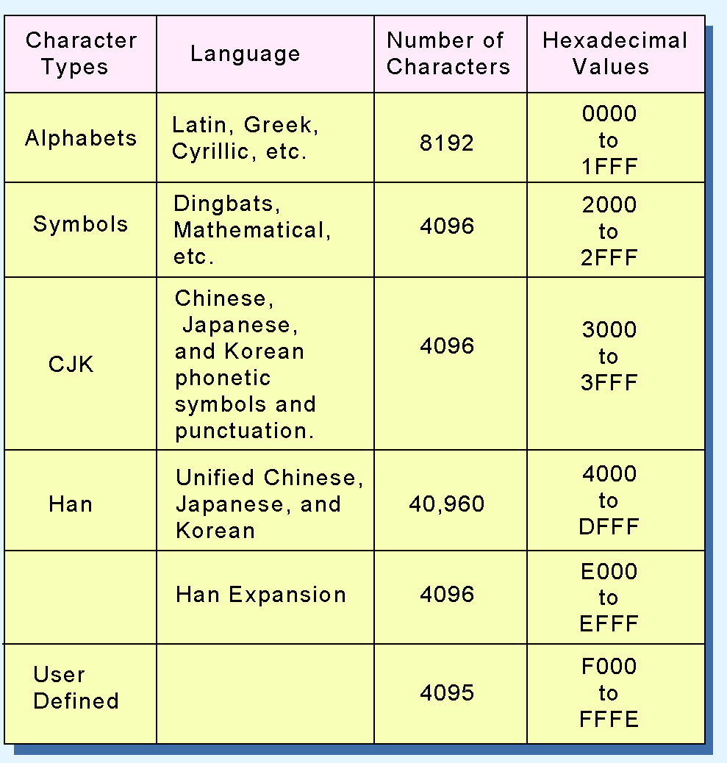
Character Codes
The Unicode codes- pace allocation is shown at the right.
The lowest-numbered Unicode characters comprise the ASCII code.
The highest provide for user-defined codes.

Slide 53
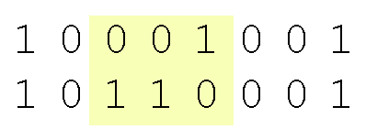
Error Detection and Correction
Hamming codes are code words formed by adding redundant check bits, or parity bits, to a data word.
The Hamming distance between two code words is the number of bits in which two code words differ.
The minimum Hamming distance for a code is the smallest Hamming distance between all pairs of words in the code.
This pair of bytes has a Hamming distance of 3:

Slide 54
Error Detection and Correction
The minimum Hamming distance for a code, D(min), determines its error detecting and error correcting capability.
For any code word, X, to be interpreted as a different valid code word, Y, at least D(min) single-bit errors must occur in X.
Thus, to detect k (or fewer) single-bit errors, the code must have a Hamming distance of D(min) = k + 1.

Slide 55
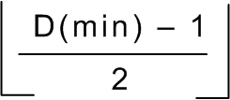
Error Detection and Correction
Hamming codes can detect D(min) - 1 errors and correct errors
Thus, a Hamming distance of 2k + 1 is required to be able to correct k errors in any data word.
Hamming distance is provided by adding a suitable number of parity bits to a data word.

Slide 56
Error Detection and Correction
Suppose we have a set of n-bit code words consisting of m data bits and r (redundant) parity bits.
Suppose also that we wish to detect and correct one single bit error only.
An error could occur in any of the n bits, so each code word can be associated with n invalid code words at a Hamming distance of 1.
Therefore, we have n + 1 bit patterns for each code word: one valid code word, and n invalid code words

Slide 57
Error Detection and Correction
Using n bits, we have 2 ^{n} possible bit patterns. We have 2 ^{m} valid code words with r check bits (where n = m + r).
For each valid codeword, we have (n+1) bit patterns (1 legal and n illegal).
This gives us the inequality:
(n + 1) × 2 ^{m} ≤ 2 ^{n}
Because n = m + r, we can rewrite the inequality as:
(m + r + 1) × 2 ^{m} ≤ 2 ^{m + r} or (m + r + 1) ≤ 2 ^{r}
This inequality gives us a lower limit on the number of check bits that we need in our code words.

Slide 58
Error Detection and Correction
Suppose we have data words of length m = 4. Then:
(4 + r + 1) ≤ 2 ^{r}
implies that r must be greater than or equal to 3.
We should always use the smallest value of r that makes the inequality true.
This means to build a code with 4-bit data words that will correct single-bit errors, we must add 3 check bits.
Finding the number of check bits is the hard part. The rest is easy.

Slide 59
Error Detection and Correction
Suppose we have data words of length m = 8. Then:
(8 + r + 1) ≤ 2 ^{r}
implies that r must be greater than or equal to 4.
This means to build a code with 8-bit data words that will correct single-bit errors, we must add 4 check bits, creating code words of length 12.
So how do we assign values to these check bits?

Slide 60
Error Detection and Correction
With code words of length 12, we observe that each of the bits, numbered 1 though 12, can be expressed in powers of 2. Thus:
1 = 2 ⁰ 5 = 2 ² + 2 ⁰ 9 = 2 ³ + 2 ⁰
2 = 2 ¹ 6 = 2 ² + 2 ¹ 10 = 2 ³ + 2 ¹
3 = 2 ¹ + 2 ⁰ 7 = 2 ² + 2 ¹ + 2 ⁰ 11 = 2 ³ + 2 ¹ + 2 ⁰
4 = 2 ² 8 = 2 ³ 12 = 2 ³ + 2 ²
1 (= 2⁰) contributes to all of the odd-numbered digits.
2 (= 2¹) contributes to the digits, 2, 3, 6, 7, 10, and 11.
. . . And so forth . . .
We can use this idea in the creation of our check bits.

Slide 61

Error Detection and Correction
Using our code words of length 12, number each bit position starting with 1 in the low-order bit.
Each bit position corresponding to a power of 2 will be occupied by a check bit.
These check bits contain the parity of each bit position for which it participates in the sum.

Slide 62

Error Detection and Correction
Since 1 (=2⁰) contributes to the values 1, 3 , 5, 7, 9, and 11, bit 1 will check parity over bits in these positions.
Since 2 (= 2¹) contributes to the values 2, 3, 6, 7, 10, and 11, bit 2 will check parity over these bits.
For the word 11010110, assuming even parity, we have a value of 1 for check bit 1, and a value of 0 for check bit 2.
What are the values for the other parity bits?

Slide 63

Error Detection and Correction
The completed code word is shown above.
Bit 1checks the bits 3, 5, 7, 9, and 11, so its value is 1 to ensure even parity within this group.
Bit 4 checks the bits 5, 6, 7, and 12, so its value is 1.
Bit 8 checks the bits 9, 10, 11, and 12, so its value is also 1.
Using the Hamming algorithm, we can not only detect single bit errors in this code word, but also correct them!

Slide 64

Error Detection and Correction
Suppose an error occurs in bit 5, as shown above. Our parity bit values are:
Bit 1 checks 1, 3, 5, 7, 9, and 11. This is incorrect as we have a total of 3 ones (which is not even parity).
Bit 2 checks bits 2, 3, 6, 7, 10, and 11. The parity is correct.
Bit 4 checks bits 4, 5, 6, 7, and 12. This parity is incorrect, as we 3 ones.
Bit 8 checks bit 8, 9, 10, 11, and 12. This parity is correct.

Slide 65
Error Detection and Correction
We have erroneous parity for check bits 1 and 4.
With two parity bits that don’t check, we know that the error is in the data, and not in a parity bit.
Which data bits are in error? We find out by adding the bit positions of the erroneous bits.
Simply, 1 + 4 = 5. This tells us that the error is in bit 5. If we change bit 5 to a 1, all parity bits check and our data is restored.

Slide 66
Conclusion
Computers store data in the form of bits, bytes, and words using the binary numbering system.
Hexadecimal numbers are formed using four-bit groups called nibbles.
Signed integers can be stored in one’s complement, two’s complement, or signed magnitude representation.
Floating-point numbers are usually coded using the IEEE 754 floating-point standard.

Slide 67
Conclusion
Floating-point operations are not necessarily commutative or distributive.
Character data is stored using ASCII, EBCDIC, or Unicode.
Error detecting and correcting codes are necessary because we can expect no transmission or storage medium to be perfect.
CRC, Reed-Solomon, and Hamming codes are three important error control codes.

Slide 68
References
Text Books:
Computer System Architecture M. M. Mano:, 3rd ed., Prentice Hall of India, New Delhi, 1993.
Computer Organization and Design: The Hardware/Software Interface, David A. Patterson and John L. Hennessy.
Computer Organization and Embedded Systems, Carl Hamacher.

Slide 69
Please Send Your Queries on:
e-Mail: jayashree.e15737@cumail.in

